Slide 1
Database Systems
Instructor:
Dr. Hamid Turab Mirza
Department of Computer Science
CUI, Lahore

Slide 2
Definitions
Database: organized collection of logically related data
Data: stored representations of meaningful objects and events
  Structured: numbers, text, dates
  Unstructured: images, video, documents
Information: data processed to increase knowledge in the person using the data
Metadata: data that describes the properties and context of user data

Slide 3
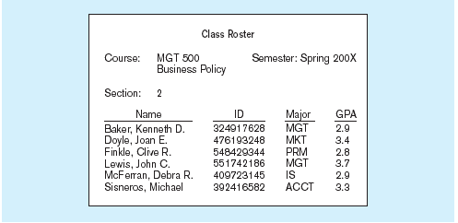
Data in context
Context helps users understand data

Slide 4
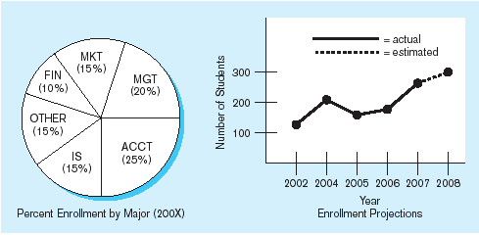
Summarized data
Graphical displays turn data into useful information that managers can use for decision making and interpretation

Slide 5
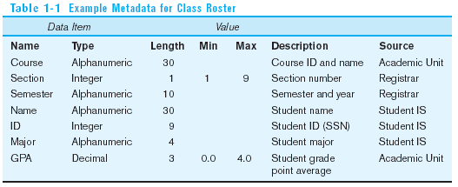
Descriptions of the properties or characteristics of the data, including data types, field sizes, allowable values, and data context

Slide 6
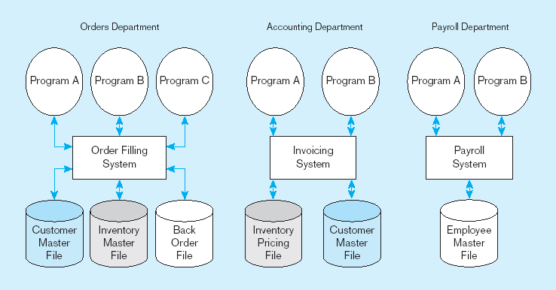
File Processing Systems

Slide 7
Disadvantages of File Processing
Program-Data Dependence
  All programs maintain metadata for each file they use
Duplication of Data
  Different systems/programs have separate copies of the same data
Limited Data Sharing
  No centralized control of data
Lengthy Development Times
  Programmers must design their own file formats
Excessive Program Maintenance
  80% of information systems budget

Slide 8
Problems with Data Dependency
Each application programmer must maintain his/her own data
Each application program needs to include code for the metadata of each file
Each application program must have its own processing routines for reading, inserting, updating, and deleting data
Lack of coordination and central control
Non-standard file formats

Slide 9
Old file processing systems at Pine Valley Furniture Company
Duplicate Data

Slide 10
Problems with Data Redundancy
Waste of space to have duplicate data
Causes more maintenance headaches
The biggest problem:
  Data changes in one file could cause inconsistencies
  Compromises in data integrity

Slide 11
SOLUTION:
The DATABASE Approach
Central repository of shared data
Data is managed by a controlling agent
Stored in a standardized, convenient form

Slide 12
Database Management System
A software system that is used to create, maintain, and provide controlled access to user databases
Order Filing
System
Central database
Contains employee,
order, inventory,
pricing, and
customer data
Invoicing
System
DBMS
Payroll
System
DBMS manages data resources like an operating system manages hardware resources

Slide 13
Advantages of the Database Approach
Program-data independence
Planned data redundancy
Improved data consistency
Improved data sharing
Increased application development productivity
Enforcement of standards
Improved data quality
Improved data accessibility and responsiveness
Reduced program maintenance
Improved decision support

Slide 14
Costs and Risks of the Database Approach
New, specialized personnel
Installation and management cost and complexity
Conversion costs
Need for explicit backup and recovery
Organizational conflict

Slide 15
The Range of Database Applications
Personal databases
Workgroup databases
Departmental/divisional databases
Enterprise database

Slide 16
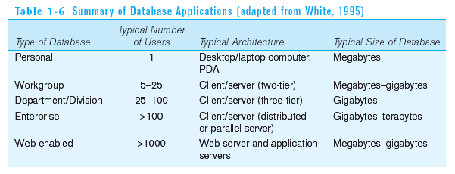

Slide 17
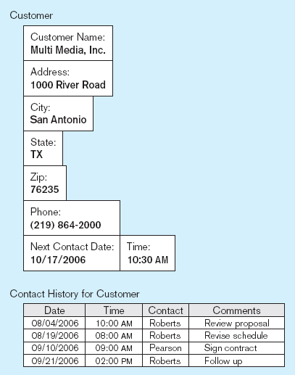
Typical data from a personal database

Slide 18
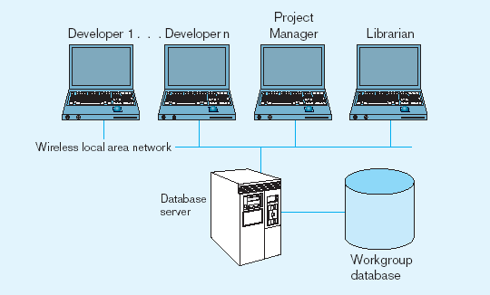
Workgroup database with wireless
local area network

Slide 19
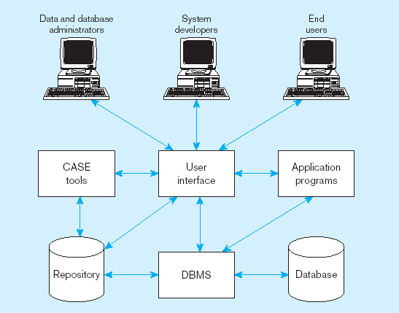
Components of the Database Environment

Slide 20
Components of the
Database Environment
CASE Tools–computer-aided software engineering
Repository–centralized storehouse of metadata
Database Management System (DBMS) –software for managing the database
Database–storehouse of the data
Application Programs–software using the data
User Interface–text and graphical displays to users
Data/Database Administrators–personnel responsible for maintaining the database
System Developers–personnel responsible for designing databases and software
End Users–people who use the applications and databases

Slide 21
Elements of the Database Approach
Data models
  Graphical system capturing nature and relationship of data
  Enterprise Data Model–high-level entities and relationships for the organization
Relational Databases
  Database technology involving tables (relations) representing entities and primary/foreign keys representing relationships
Use of Internet Technology
  Networks and telecommunications, distributed databases, client-server, and 3-tier architectures
Database Applications
  Application programs used to perform database activities (create, read, update, and delete) for database users

Slide 22
Enterprise Data Model
First step in database development
Specifies scope and general content
Overall picture of organizational data at high level of abstraction
Entity-relationship diagram
Descriptions of entity types
Relationships between entities
Business rules

Slide 23
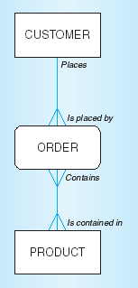
Segment from enterprise data model
Enterprise data model describes the high-level entities in an organization and the relationship between these entities

Slide 24
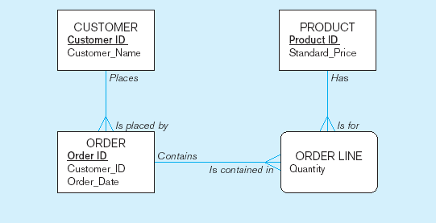
Segment of an Enterprise Data Model

Slide 25
One customer may place many orders, but each order is placed by a single customer
→ One-to-many relationship

Slide 26
One order has many order lines; each order line is associated with a single order
→ One-to-many relationship

Slide 27
One product can be in many order lines, each order line refers to a single product
→ One-to-many relationship

Slide 28
Business Rules
Statements that define or constrain some aspect of the business
Assert business structure
Control/influence business behavior
Expressed in terms familiar to end users
Automated through DBMS software

Slide 29
A Good Business Rule is:
Declarative–what, not how
Precise–clear, agreed-upon meaning
Atomic–one statement
Consistent–internally and externally
Expressible–structured, natural language
Distinct–non-redundant
Business-oriented–understood by business people

Slide 30
A Good Data Name is:
Related to business, not technical, characteristics
Meaningful and self-documenting
Unique
Readable
Composed of words from an approved list
Repeatable

Slide 31
Data Definitions
Explanation of a term or fact
  Term–word or phrase with specific meaning
  Fact–association between two or more terms
Guidelines for good data definition
  Gathered in conjunction with systems requirements
  Accompanied by diagrams
  Iteratively created and refined
  Achieved by consensus

Slide 32
E-R Model Constructs
Entities:
  Entity instance–person, place, object, event, concept (often corresponds to a row in a table)
  Entity Type–collection of entities (often corresponds to a table)
Relationships:
  Relationship instance–link between entities (corresponds to primary key-foreign key equivalencies in related tables)
  Relationship type–category of relationship…link between entity types
Attribute–property or characteristic of an entity or relationship type (often corresponds to a field in a table)
Notes:
2

Slide 33
Sample E-R Diagram - 1
Pine valley furniture company can purchase items
from a number of different suppliers, who then ship
the items to the manufacturer. The items are
assembled into products that are sold to customers
who order the products. Each customer order may
include one or more lines corresponding to the
Products appearing on that order.
Notes:
2

Slide 34
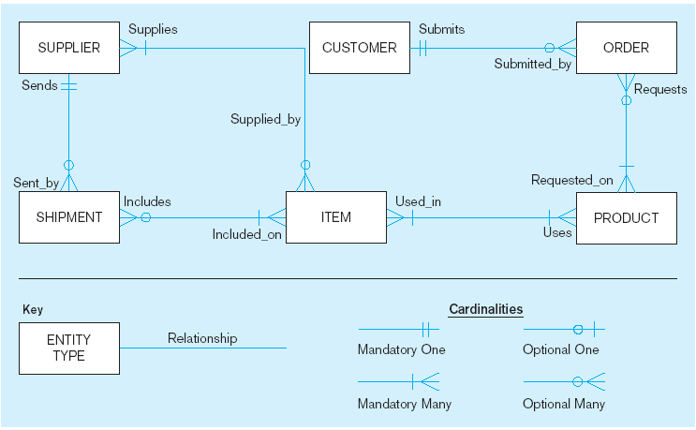
Sample E-R Diagram
A SUPPLIER may supply many ITEMs (by “may supply” we mean the supplier may not supply any items). Each ITEM is supplied by any number of SUPPLIERs (by “is supplied” we mean must be supplied by at least one supplier).
Each ITEM must be used in the assembly of at least one PRODUCT, and may be used in many products. Conversely, each PRODUCT must use one or more ITEMs.
A SUPPLIER may send many SHIPMENTs. On the other hand, each shipment must be sent by exactly one SUPPLIER.
A SHIPMENT must include one (or more) ITEMs. An ITEM may be included on several SHIPMENTs.
A CUSTOMER may submit any number of ORDERs. However, each ORDER must be submitted by exactly one CUSTOMER.
An ORDER must request one (or more) PRODUCTs. A given PRODUCT may not be requested on nay ORDER, or may be requested one one or more orders.
Notes:
3

Slide 35
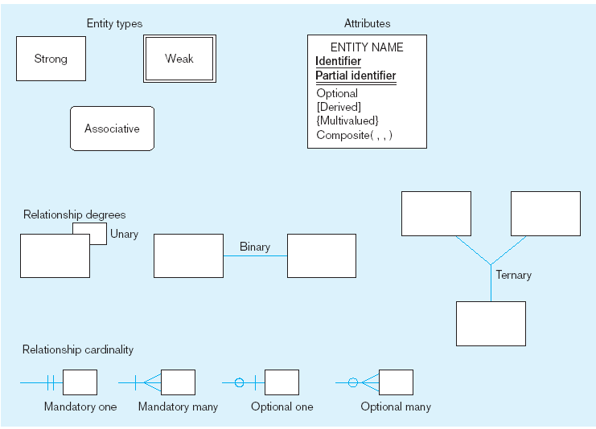
Basic E-R notation
Entity symbols
Attribute symbols
A special entity that is also a relationship
Relationship symbols
Relationship degrees specify number of entity types involved
Relationship cardinalities specify how many of each entity type is allowed
Notes:
8

Slide 36
What Should an Entity Be?
SHOULD BE:
  An object that will have many instances in the database
  An object that will be composed of multiple attributes
  An object that we are trying to model
SHOULD NOT BE:
  A user of the database system
  An output of the database system (e.g., a report)

Slide 37
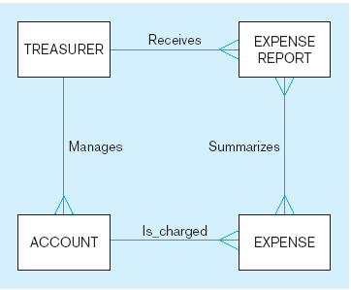
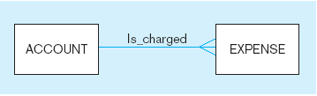
Example of inappropriate entities
System
user
System output
Inappropriate entities
Appropriate entities

Slide 38
Attributes
Attribute–property or characteristic of an entity or relationahip type
Classifications of attributes:
  Required versus Optional Attributes
  Simple versus Composite Attribute
  Single-Valued versus Multivalued Attribute
  Stored versus Derived Attributes
  Identifier Attributes
Notes:
5

Slide 39
Identifiers (Keys)
Identifier (Key)–An attribute (or combination of attributes) that uniquely identifies individual instances of an entity type
Simple versus Composite Identifier
Candidate Identifier–an attribute that could be a key…satisfies the requirements for being an identifier
Notes:
6

Slide 40
Characteristics of Identifiers
Will not change in value
Will not be null
No intelligent identifiers (e.g., containing locations or people that might change)
Notes:
7

Slide 41
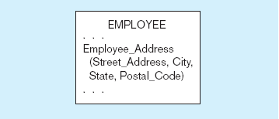
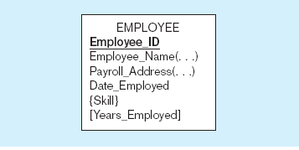
A composite attribute
An attribute broken into component parts
Entity with multivalued attribute (Skill)
and derived attribute (Years_Employed)
Multivalued
an employee can have
more than one skill
Derived
from date employed and current date
Notes:
12

Slide 42
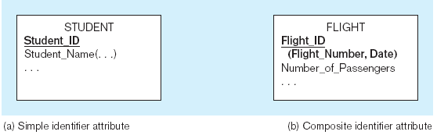
Simple and composite identifier attributes
The identifier is boldfaced and underlined
Notes:
14

Slide 43
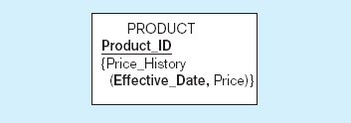
Simple example of time-stamping
This attribute that is both multivalued and composite
Notes:
37

Slide 44
Relationships
  Examples of relationship types:
  A branch is managed by at most one manager
  A manager can manage at most one branch
  A transaction can update one account
  An account can be updated by many transactions
  A customer can own many accounts
  An account may be owned by more than one customer

Slide 45
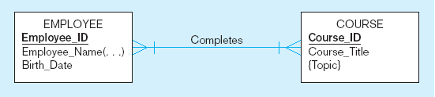
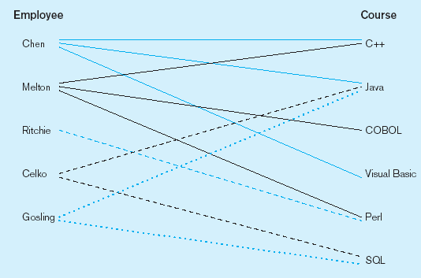
Relationship types and instances
a) Relationship type
b) Relationship instances
Notes:
17

Slide 46
Cardinality of Relationships
One-to-One
  Each entity in the relationship will have exactly one related entity
One-to-Many
  An entity on one side of the relationship can have many related entities, but an entity on the other side will have a maximum of one related entity
Many-to-Many
  Entities on both sides of the relationship can have many related entities on the other side

Slide 47
Cardinality Constraints
Cardinality Constraints - the number of instances of one entity that can or must be associated with each instance of another entity
Minimum Cardinality
  If zero, then optional
  If one or more, then mandatory
Maximum Cardinality
  The maximum number
Notes:
29

Slide 48
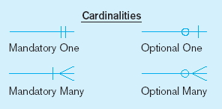
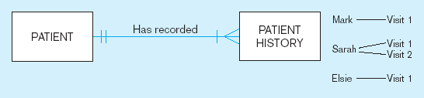
Examples of cardinality constraints
a) Mandatory cardinalities
A patient history is recorded for one and only one patient
A patient must have recorded at least one history, and can have many
Notes:
1

Slide 49
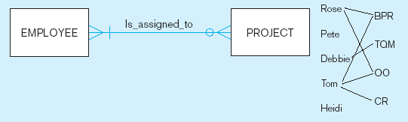
Examples of cardinality constraints (cont.)
b) One optional, one mandatory
A project must be assigned to at least one employee, and may be assigned to many
An employee can be assigned to any number of projects, or may not be assigned to any at all
Notes:
1

Slide 50
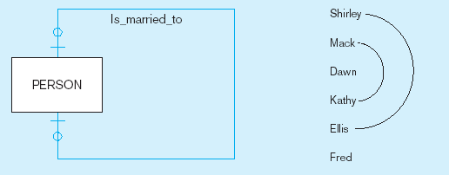
Examples of cardinality constraints (cont.)
a) Optional cardinalities
A person is is married to at most one other person, or may not be married at all
Notes:
1

Slide 51
Sample E-R Diagram – 2
ABC housing society is a medium sized local authority. One of the responsibilities of the
Society is the maintenance and repair of Society owned housing within its boundaries. The
authority wishes to develop an information system to monitor information on housing
repair work, a description of which is as follows:
“For the purpose of housing repair work, the society is divided into a number of areas.
Each area is subdivided into streets or roads, each street or road in likely to have a number
of houses along it. Details of each house are held, along with details of each instance of
repair work carried out to a specific house. Each area is maintained by a single repair team,
although a team may be responsible for more than one area. A repair team consists of a
number of employees, one of whom is designated the team supervisor. The team are
allocated a number of vehicles for use in their work, which are generally used by the
“owning” team only, although are occasionally “borrowed” by other Teams. Each team is
based at a maintenance depot, and in some cases, more than one team may be based at a
single depot”.
Notes:
2

Slide 52
Sample E-R Diagram - 2 (Entities Identified)
ABC housing society is a medium sized local authority. One of the responsibilities of the
Society is the maintenance and repair of Society owned housing within its boundaries. The
authority wishes to develop an information system to monitor information on housing
repair work, a description of which is as follows:
“For the purpose of housing repair work, the society is divided into a number of areas.
Each area is subdivided into streets or roads, each street or road in likely to have a
number of houses along it. Details of each house are held, along with details of each
instance of repair work carried out to a specific house. Each area is maintained by a
single repair team, although a team may be responsible for more than one area. A repair
team consists of a number of employees, one of whom is designated the team supervisor.
The team are allocated a number of vehicles for use in their work, which are generally
used by the “owning” team only, although are occasionally “borrowed” by other Teams.
Each team is based at a maintenance depot, and in some cases, more than one team may be
based at a single depot”.
Notes:
2

Slide 53
Relation
Definition: A relation is a named, two-dimensional table of data
Table consists of rows (records) and columns (attribute or field)
Requirements for a table to qualify as a relation:
  It must have a unique name
  Every attribute value must be atomic (not multivalued, not composite)
  Every row must be unique (can’t have two rows with exactly the same values for all their fields)
  Attributes (columns) in tables must have unique names
  The order of the columns must be irrelevant
  The order of the rows must be irrelevant

Slide 54
Correspondence with E-R Model
Relations (tables) correspond with entity types and with many-to-many relationship types
Rows correspond with entity instances and with many-to-many relationship instances
Columns correspond with attributes
NOTE: The word relation (in relational database) is NOT the same as the word relationship (in E-R model)

Slide 55

Key Fields
Keys are special fields that serve two main purposes:
  Primary keys are unique identifiers of the relation in question. Examples include employee numbers, social security numbers, etc. This is how we can guarantee that all rows are unique
  Foreign keys are identifiers that enable a dependent relation (on the many side of a relationship) to refer to its parent relation (on the one side of the relationship)
Keys can be simple (a single field) or composite (more than one field)
Keys usually are used as indexes to speed up the response to user queries (Discussed Latter)

Slide 56
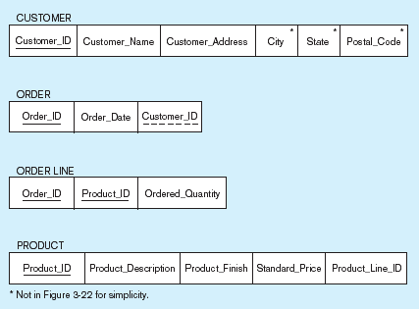
Schema for four relations (Pine Valley Furniture Company)
Primary Key
Foreign Key (implements 1:N relationship between customer and order)
Combined, these are a composite primary key (uniquely identifies the order line)…individually they are foreign keys (implement M:N relationship between order and product)

Slide 57
Integrity Constraints
Domain Constraints
  Allowable values for an attribute. See Table 5-1
Entity Integrity
  No primary key attribute may be null. All primary key fields MUST have data
Action Assertions
  Business rules.

Slide 58
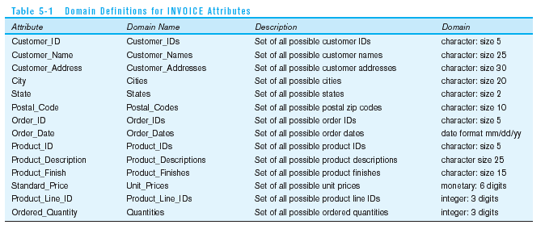
Domain definitions enforce domain integrity constraints

Slide 59
Integrity Constraints
Referential Integrity–rule states that any foreign key value (on the relation of the many side) MUST match a primary key value in the relation of the one side. (Or the foreign key can be null)
  For example: Delete Rules
    Restrict–don’t allow delete of “parent” side if related rows exist in “dependent” side
    Cascade–automatically delete “dependent” side rows that correspond with the “parent” side row to be deleted
    Set-to-Null–set the foreign key in the dependent side to null if deleting from the parent side → not allowed for weak entities

Slide 60
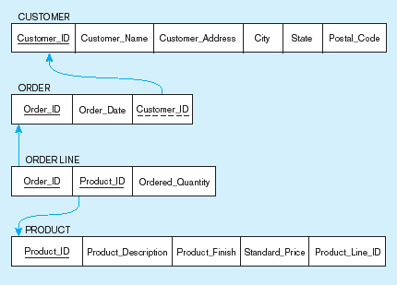
Referential integrity constraints (Pine Valley Furniture)
Referential integrity constraints are drawn via arrows from dependent to parent table

Slide 61
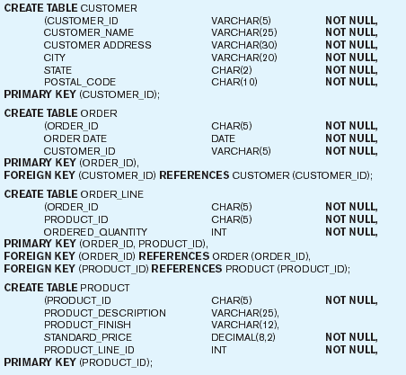
SQL table definitions
Referential integrity constraints are implemented with foreign key to primary key references

Slide 62
Transforming EER Diagrams into Relations
Mapping Regular Entities to Relations
  Simple attributes: E-R attributes map directly onto the relation
  Composite attributes: Use only their simple, component attributes
  Multivalued Attribute–Becomes a separate relation with a foreign key taken from the superior entity

Slide 63


Mapping a regular entity
(a) CUSTOMER entity type with simple attributes
(b) CUSTOMER relation

Slide 64


Mapping a composite attribute
(a) CUSTOMER entity type with composite attribute
(b) CUSTOMER relation with address detail

Slide 65

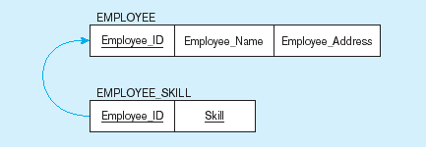
Mapping an entity with a multivalued attribute
(a)
Multivalued attribute becomes a separate relation with foreign key
(b)
One–to–many relationship between original entity and new relation

Slide 66
Transforming EER Diagrams into Relations (cont.)
Mapping Binary Relationships
  One-to-Many–Primary key on the one side becomes a foreign key on the many side
  Many-to-Many–Create a new relation with the primary keys of the two entities as its primary key
  One-to-One–Primary key on the mandatory side becomes a foreign key on the optional side

Slide 67
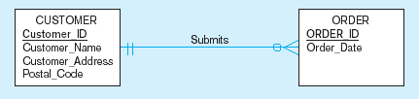
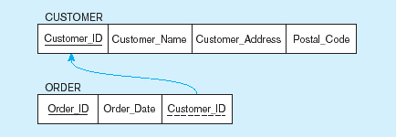
Example of mapping a 1:M relationship
a) Relationship between customers and orders
Note the mandatory one
b) Mapping the relationship
Again, no null value in the foreign key…this is because of the mandatory minimum cardinality
Foreign key

Slide 68
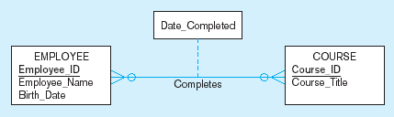
Example of mapping an M:N relationship
a) Completes relationship (M:N)
The Completes relationship will need to become a separate relation

Slide 69
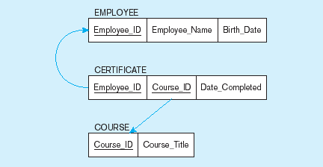
Example of mapping an M:N relationship (cont.)
b) Three resulting relations
Composite primary key
Foreign key
New intersection relation
Foreign key

Slide 70
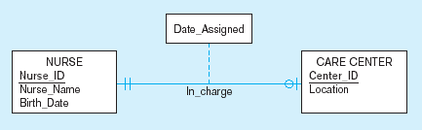
Example of mapping a binary 1:1 relationship
a) In_charge relationship (1:1)
Often in 1:1 relationships, one direction is optional.

Slide 71
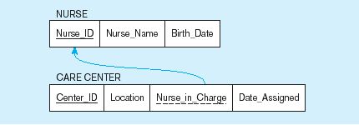
Example of mapping a binary 1:1 relationship (cont.)
b) Resulting relations
Foreign key goes in the relation on the optional side,
Matching the primary key on the mandatory side

Slide 72
Transforming EER Diagrams into Relations (cont.)
Mapping Unary Relationships
  One-to-Many–Recursive foreign key in the same relation
  Many-to-Many–Two relations:
    One for the entity type
    One for an associative relation in which the primary key has two attributes, both taken from the primary key of the entity

Slide 73
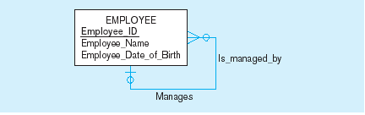

Mapping a unary 1:N relationship
(a) EMPLOYEE entity with unary relationship
(b) EMPLOYEE relation with recursive foreign key

Slide 74
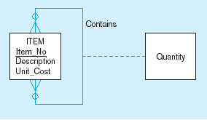
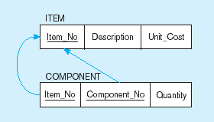
Mapping a unary M:N relationship
(a) Bill-of-materials relationships (M:N)
(b) ITEM and COMPONENT relations

Slide 75
Transforming EER Diagrams into Relations (cont.)
Mapping Ternary (and n-ary) Relationships
  One relation for each entity and one for the associative entity
  Associative entity has foreign keys to each entity in the relationship

Slide 76
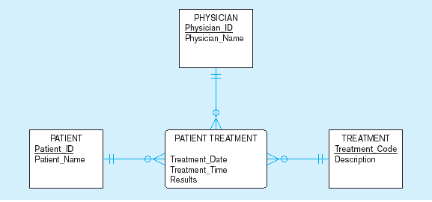
Mapping a ternary relationship
a) PATIENT TREATMENT Ternary relationship with associative entity

Slide 77
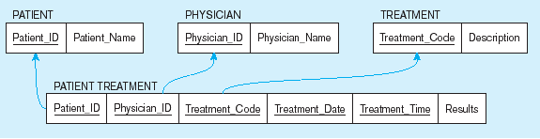
Mapping a ternary relationship (cont.)
b) Mapping the ternary relationship PATIENT TREATMENT
Remember that the primary key MUST be unique
This is why treatment date and time are included in the composite primary key
But this makes a very cumbersome key…
It would be better to create a surrogate key like Treatment#

